Slide 1
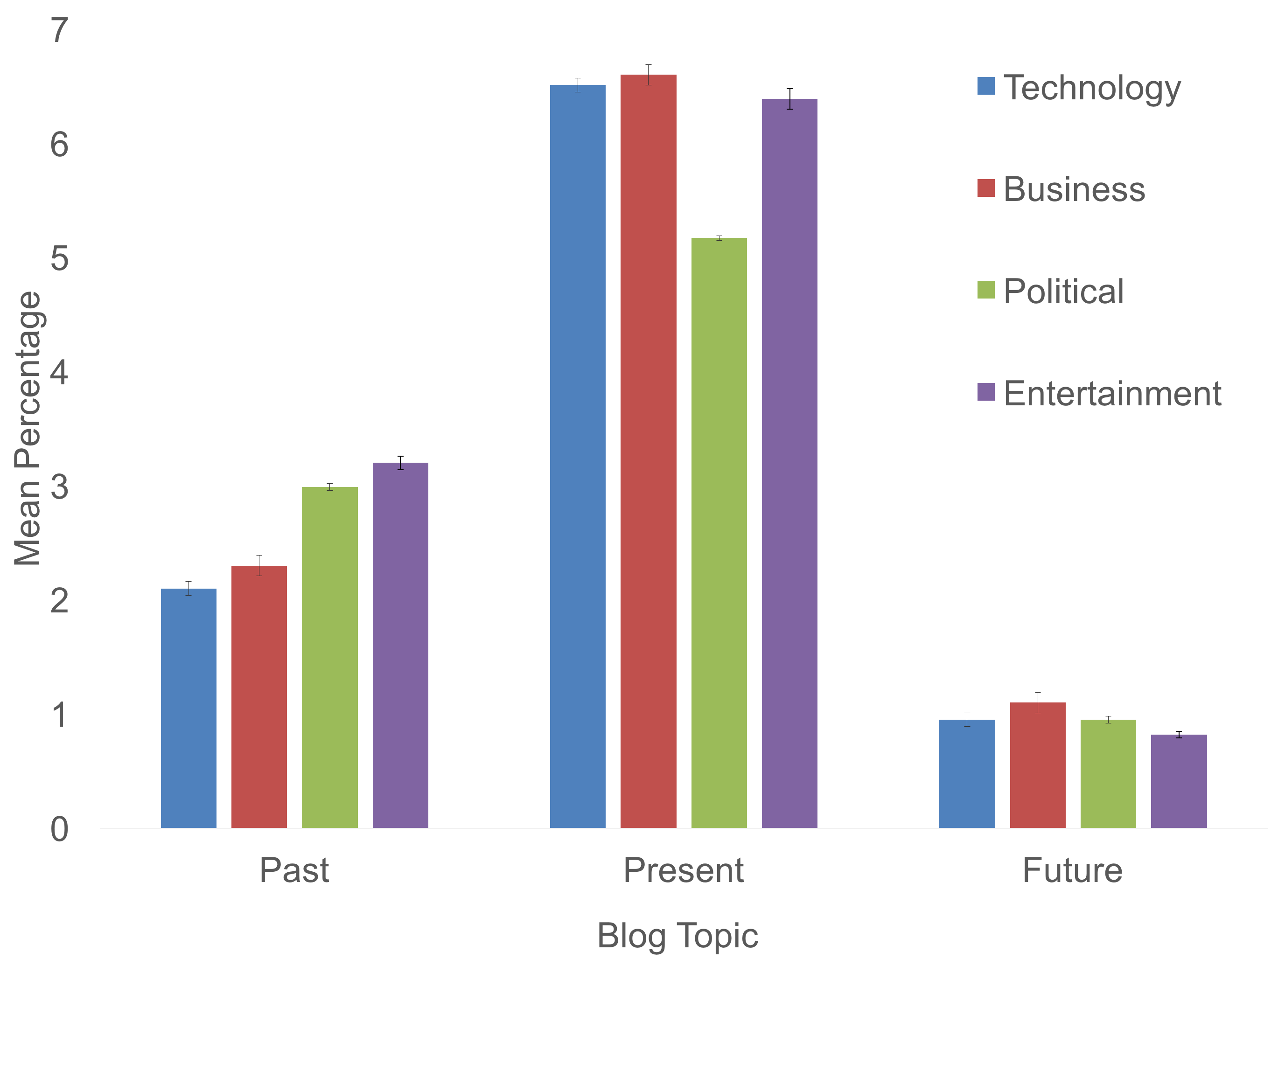

Past and Present: Verb Tenses Across Blog Topics
Spenser Phillips, Erin M. Buchanan, Ph.D.
Department of Psychology, Missouri State University, Springfield, MO
INTRODUCTION
RESULTS
CONCLUSIONS
This study is based on original research by Johnson, Buchanan, and Jordan (2014). While the original study analyzed ways to classify blogs, this study focused on analyzing writing style.
The method used for studying language and writing varies depending on what the researcher wishes to analyze. Common choices are personality and student essays.
Often research involves having judges or raters read texts and score them, such as in Brossel and Ash (1984). Relatively little has been done using pure word counts, as certain nuances such as context or sarcasm can be lost when looking solely at numbers.
LIWC, the program this study used for analysis, was created to fix these problems and allow for better investigations using word counts (Pennebaker & King,1999).
This study focused specifically on verb tenses. It was expected that blog topic would have a significant effect on the usage frequency of each verb tense. One specific example is that technology and political blogs were expected to have the highest frequencies of future tense verbs, owing to the nature of their subject matter.
A 4 (blog type) X 3 (verb tense) factorial ANOVA was analyzed on percent of verbs for this data.
  A significant main effect of blog type was found, F(3, 2386) = 39.22, p < .001, n_{p}² = .05.
  A significant main effect of verb tense was found, F(2, 4722) = 6402.82, p < .001, n_{p}² = .73.
  A significant interaction was found across both variables, F(6, 4772) = 7.53, p < .001, n_{p}² = .08.
Figure 1 shows the means and SEs for the interaction.
To analyze the interaction, tense was split into three different between-subjects ANOVAs analyzing blog type.
  Past: F(6, 4772) = 75.03, p < .001, n_{p}² = .09.
  Present: F(6, 4772) = 61.87, p < .001, n_{p}² = .07.
  Future: F(6, 4772) = 23.07, p < .001, n_{p}² = .03.
Simplified post hoc test results using a Tukey correction:
  Past: Technology = Business < Politics = Entertainment
  Present: Politics < Entertainment = Technology = Business
  Future: Entertainment < Politics = Technology < Business
Significant interactions were found across all blog topics and verb tenses.
The interactions found were inconsistent. No one topic was either highest or lowest for all tenses, and the topics frequently traded ranks. Entertainment for example had the most past tense verbs, a middle of the road number of present tense verbs, and the lowest number of future tense verbs.
The results were not as expected. A significant interaction was found, but it was expected that the results would be more consistent and a clear that technology and political blogs would have the highest frequency of future tense verbs.
FUTURE DIRECTIONS
One potential extension could involve rerunning this study during a presidential election year. The election could significantly influence the political blogs.
One could also examine the comments sections, which both this and the original study ignored. Many of the same analyses could be performed on the comments. Beware of the comment wars and hate speech for which comment sections are infamous.
Understanding how higher status blogs target their audiences through writing style could help smaller blogs grow their readership, or help larger blogs appeal to ever wider audiences.
METHODS
All data were originally collected by Johnson et. al (2014). Four topics were picked: politics, technology, entertainment, and business.
Three high and three low ranked blogs were picked for each topic; ranking was based on authority and linking behavior. While important to the original study, status of the blog was not considered in this analysis, only topic.
Front page posts no older than 2011 were copied—minus the comments—spellchecked, and corrected. Single letters other than a or I were removed, as were any words that couldn’t be categorized as a noun, verb, acronym, etc.
Each of the blog topics and rankings were copied until over a million words were reached.
These data were then analyzed with the LIWC software, which calculates percentages of different categories in text.
REFERENCES
Johnson, C. C., Buchanan, E. M., & Jordan, K. N. (2014). Blog topic and word frequency: What differentiates between high and low powered blogs?. Psychology Of Popular Media Culture,3(3), 154-163. doi:10.1037/ppm0000036
Brossell, G., & Ash, B. H. (1984). An Experiment with the Wording of Essay Topics. College Composition and Communication, 35(4), 423-425
Pennebaker, J. W., & King, L. A. (1999). Linguistic styles: Language use as an individual difference. Journal Of Personality And Social Psychology, 77(6), 1296-1312. doi:10.1037/0022-3514.77.6.1296
Balota, D. A., Yap, M. J., Cortese, M. J., Hutchison, K. A., Kessler, B., Loftis, B., . . .Treiman, R. (2007). The English Lexicon project. Behavior Research Methods, 39, 445–459. doi:10.3758/BF03193014
Figure 1. Graph of Topics and Mean Percentages of Tense Usage
Questions? Contact:Spenser Phillips(scp1993@yahoo.com) or Erin Buchanan (erinbuchanan@missouristate.edu)

